Slide 1
Design of light weight assistive exoskeleton for individuals with mobility disorder

Slide 2
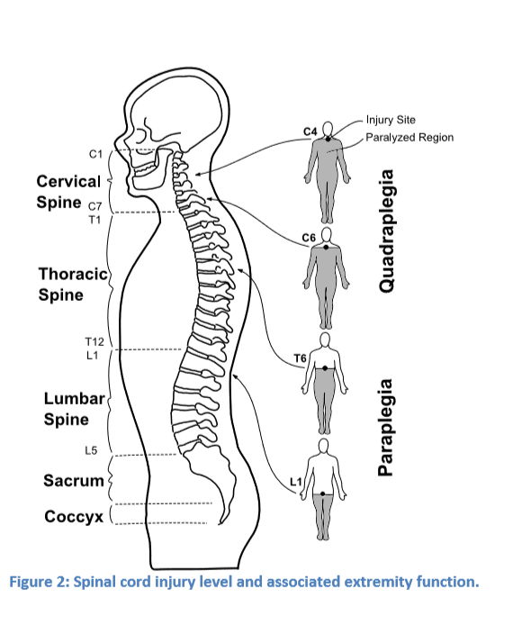
SPINAL INJURY AND IT’S EFFECT
Typically, individuals with higher injuries (upper thoracic or cervical spine) will suffer from increased levels of impairment as they will be left with reduced functionality below their injury level

Slide 3
PASSIVE DEVICES
These devices assist by constraining lower extremity joint motion so that residual upper body muscles can be used for locomotion
This approach requires substantial upper body strength and crutches or a walker for balance
Ambulation with the passive device requires up to 14 times more energy
It is possible to reduce the metabolic cost of ambulation with passive orthotics through the introduction of functional electrical stimulation (FES)

Slide 4
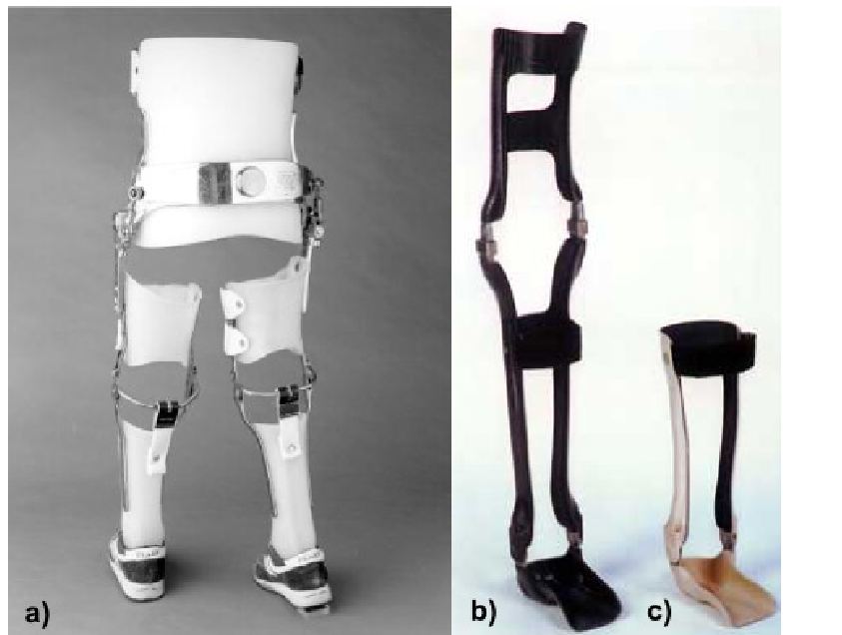
PASSIVE DEVICES

Slide 5
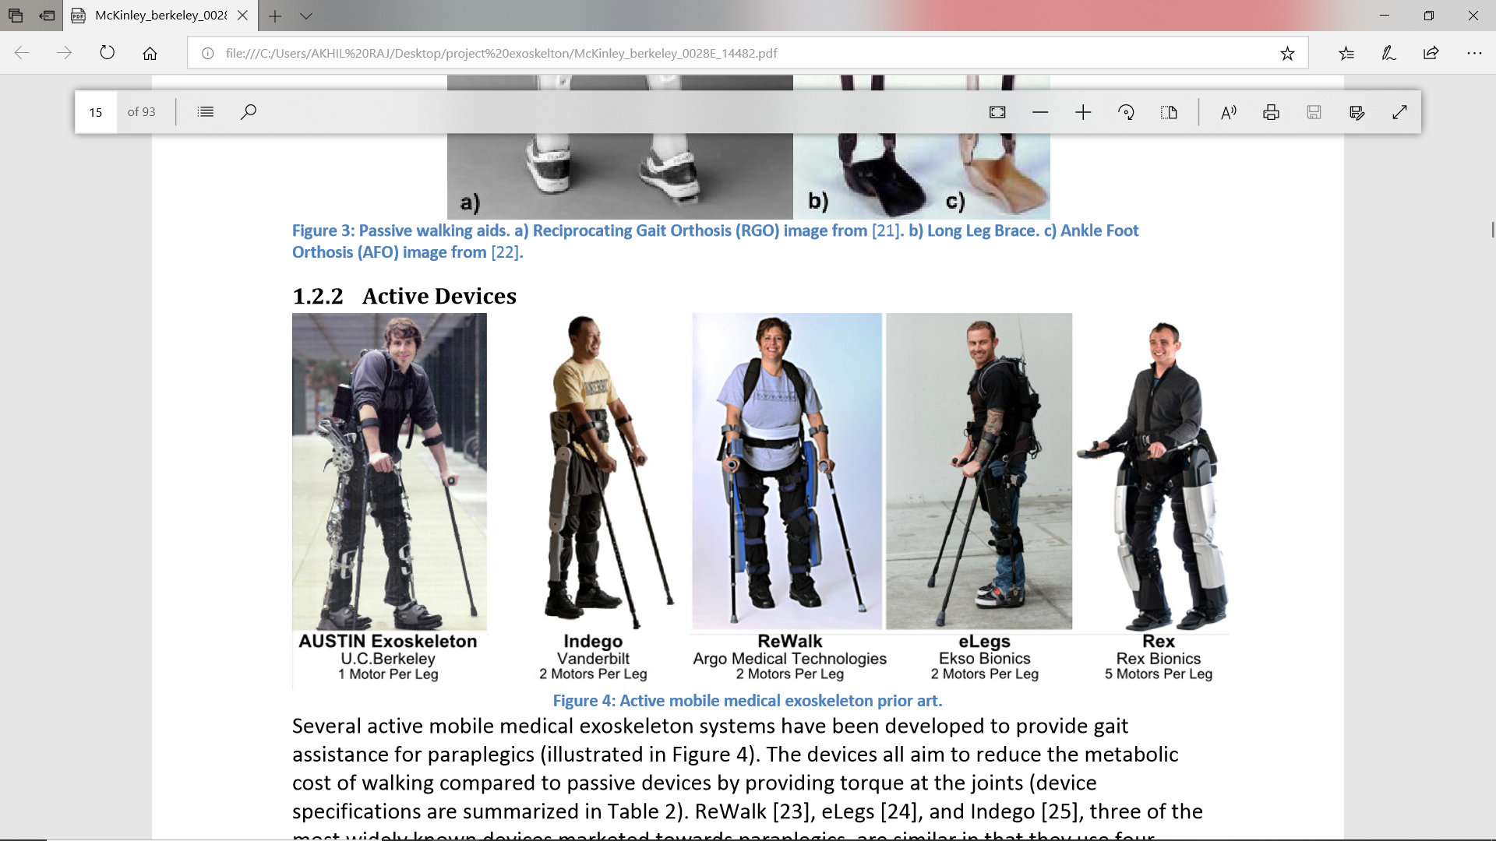
Active Devices
Several active mobile medical exoskeleton systems have been developed to provide gait assistance for paraplegics
The devices all aim to reduce the metabolic cost of walking compared to passive devices by providing torque at the joints
ReWalk [23], eLegs [24], and Indego [25], three of the most widely known devices marketed towards paraplegics

Slide 6
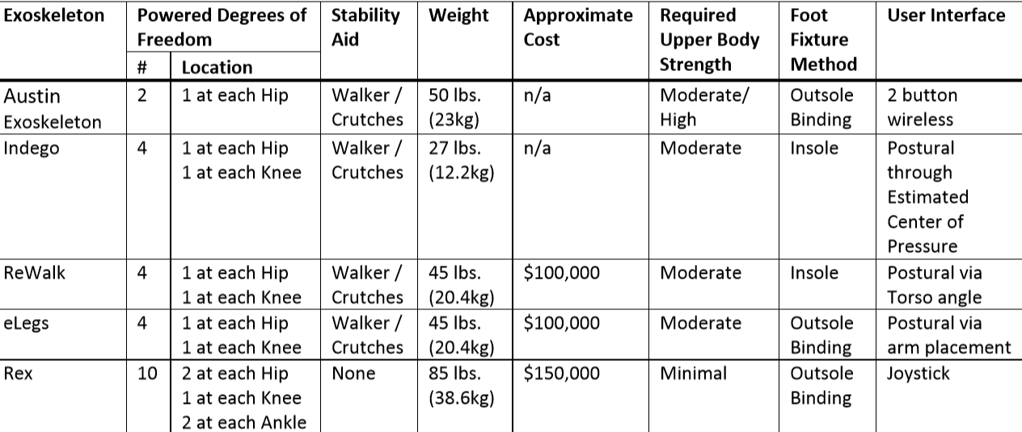
SUMMARY OF ACTIVE MEDICAL EXOSKELETONS

Slide 7
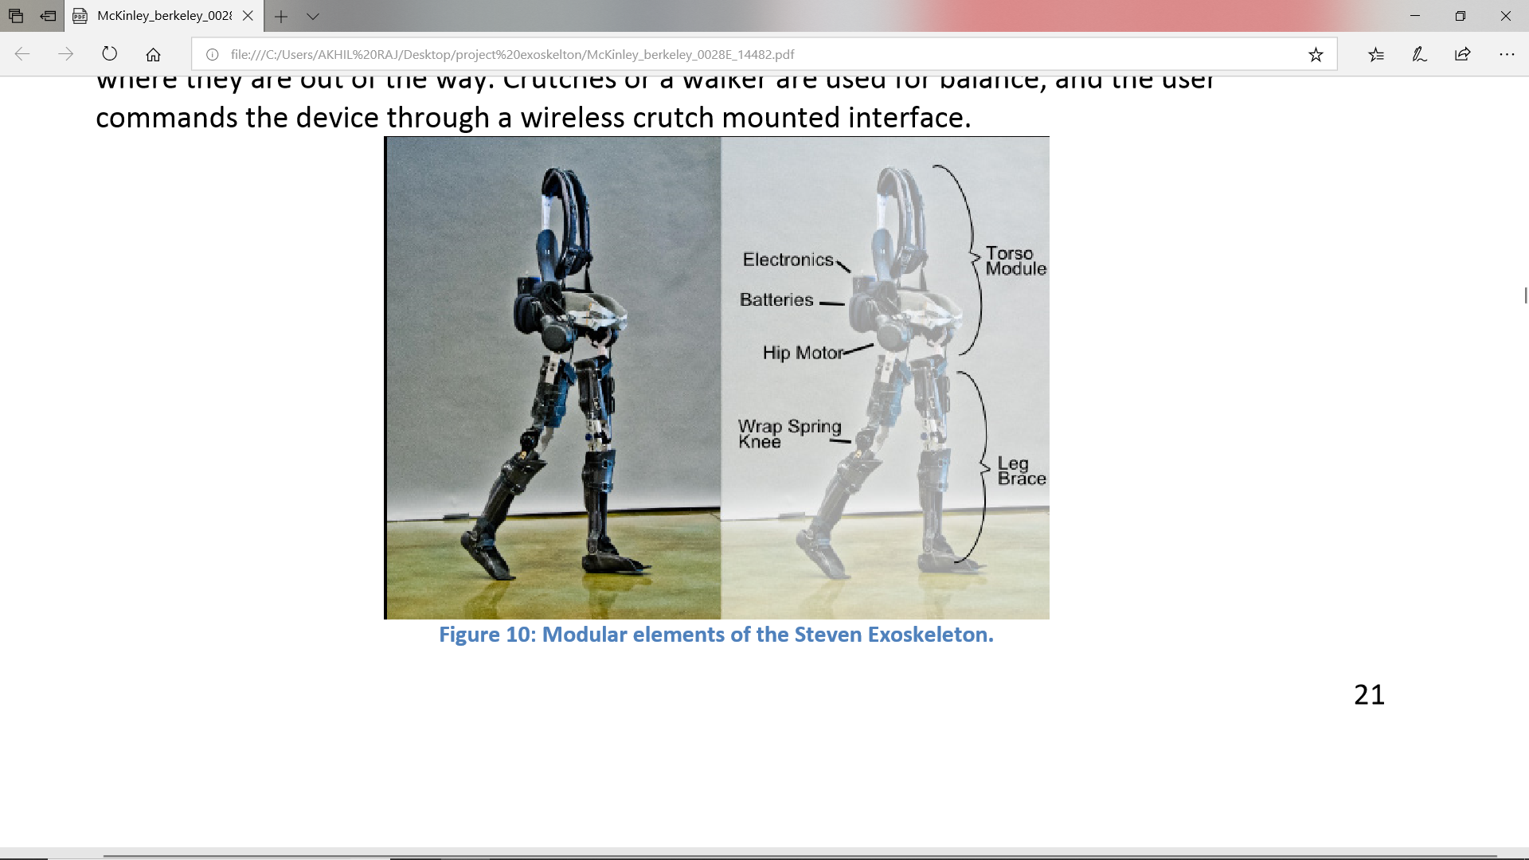
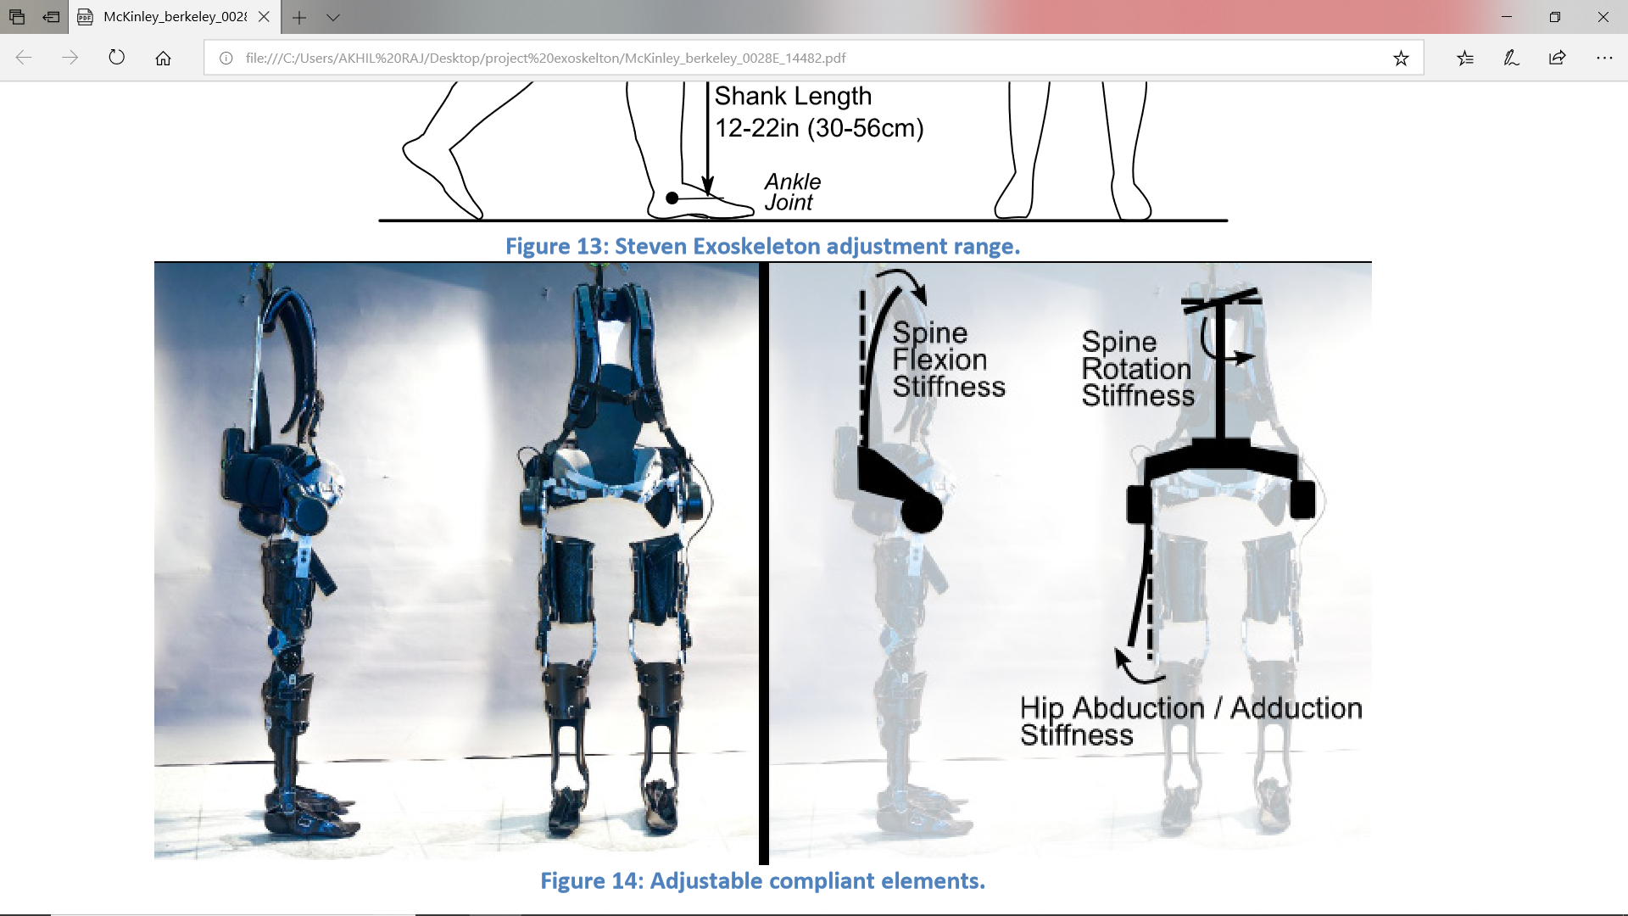
STEVEN EXOSKELETON

Slide 8
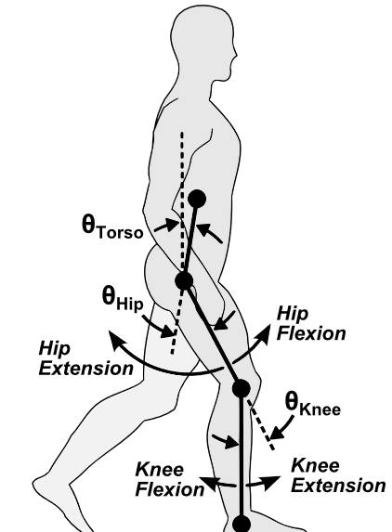
DEFINITION OF TERMS
As illustrated in Figure joint angles are defined with positive values indicating joint flexion, and negative values indicating joint extension.
A walking gait is subdivided into stance phase and swing phase .Stance phase occurs when a foot is in contact with the ground, and swing phase when the foot is not contacting the ground

Slide 9
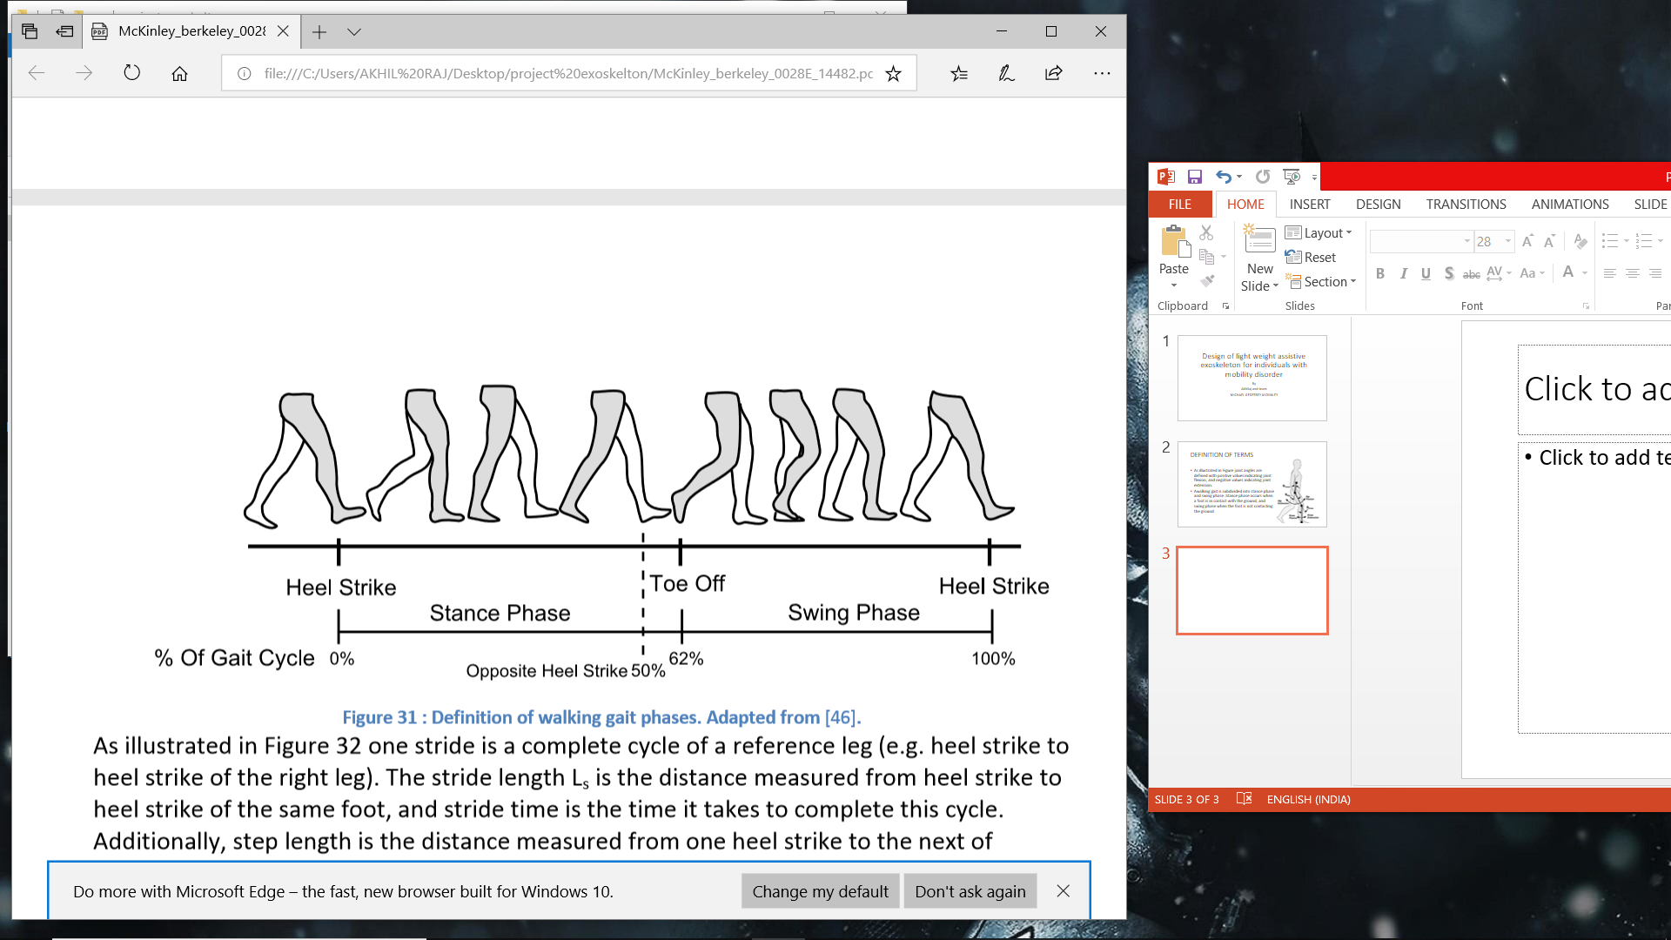
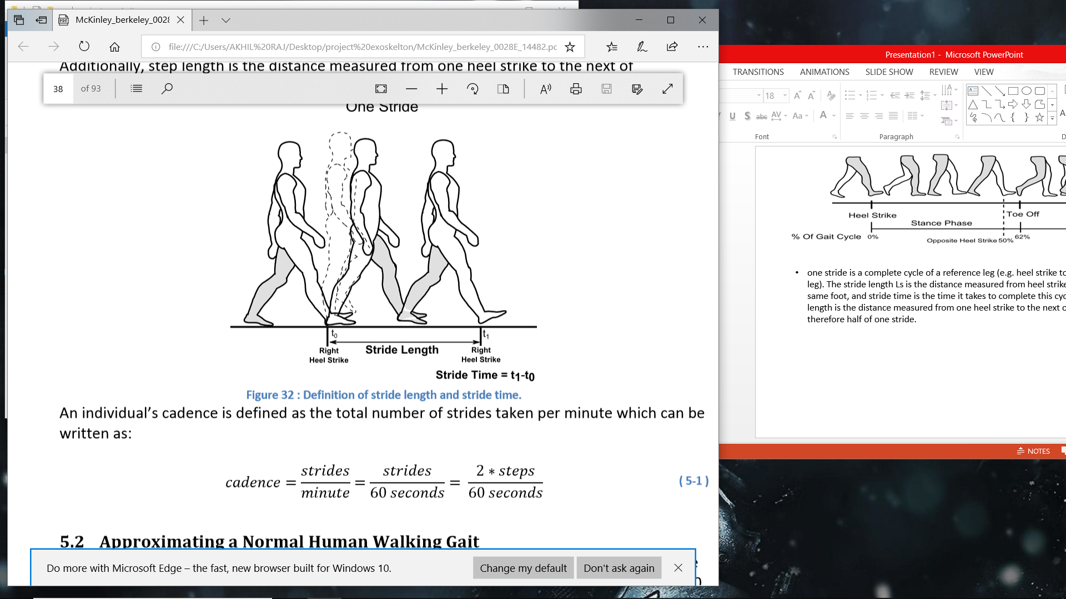
one stride is a complete cycle of a reference leg (e.g. heel strike to heel strike of the right leg). The stride length Ls is the distance measured from heel strike to heel strike of the same foot, and stride time is the time it takes to complete this cycle. Additionally, step length is the distance measured from one heel strike to the next of subsequent feet and is therefore half of one stride.
Cadence=strides/minute; strides/60sec; 2*steps/60s

Slide 10
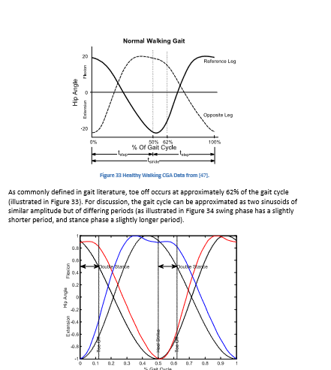
It can be seen that the left and right legs follow similar trajectories, but with a 180 degree phase shift as heel-strike of the opposing leg occurs at approximately 50% of the gait cycle.
The gait cycle can be approximated as two sinusoids of similar amplitude but of differing periods
‘tstance’ equal to the duration of stance phase, the angular frequency of the sinusoid associated with stance phase can be written as:
𝜔𝑠𝑡𝑎𝑛𝑐𝑒=2𝜋 /𝑡𝑠𝑡𝑎𝑛𝑐𝑒

Slide 11
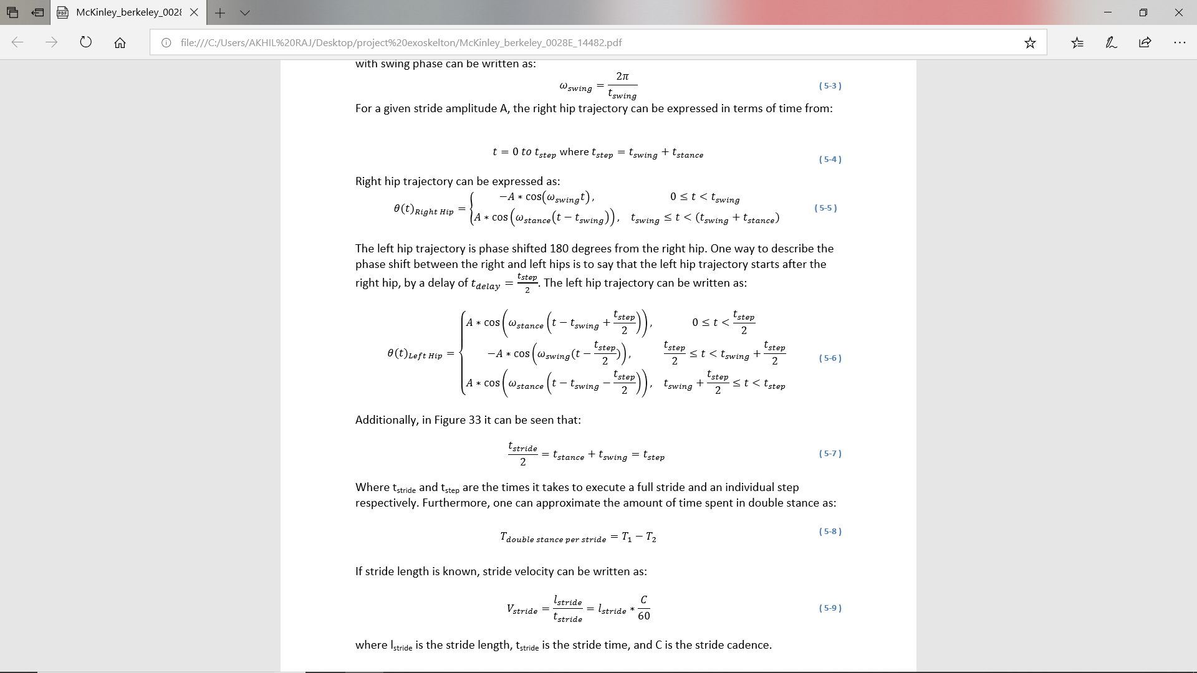

Slide 12
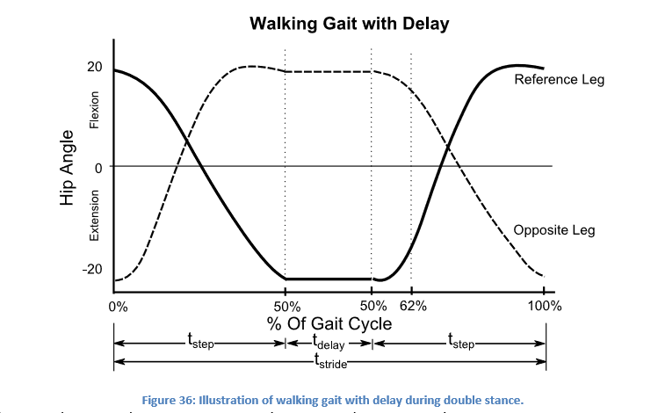
CONTINUES WALKING THROUGH GAIT DELAY MODULATION
𝑡𝑠𝑡𝑟𝑖𝑑𝑒=2∗𝑡𝑠𝑡𝑒𝑝+𝑡𝑑𝑒𝑙𝑎𝑦
𝑉 𝑎𝑣𝑔= 𝑙𝑠𝑡𝑟𝑖𝑑𝑒/( 𝑡𝑠𝑡𝑟𝑖𝑑𝑒+𝑡𝑑𝑒𝑙𝑎𝑦)
Through this method average walking velocity can be adjusted by varying the delay between steps. This approach to controlling walking velocity will be referred to as Gait Delay Modulation (GDM), as it is analogous to controlling the velocity of a DC motor through pulse width modulation

Slide 13
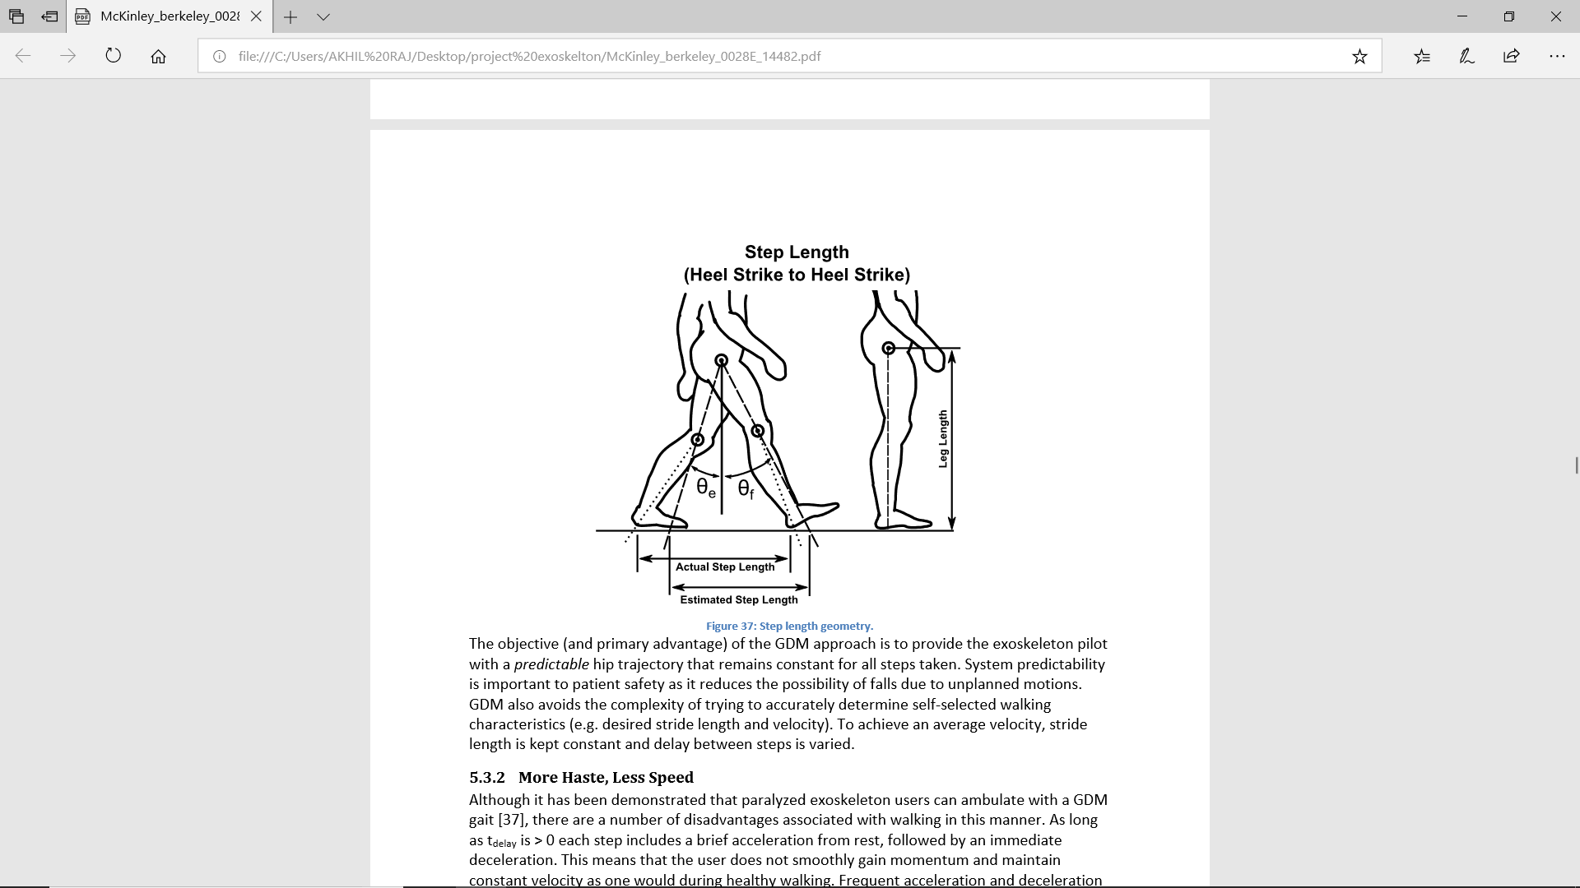
The objective (and primary advantage) of the GDM approach is to provide the exoskeleton pilot with a predictable hip trajectory that remains constant for all steps taken.
System predictability is important to patient safety as it reduces the possibility of falls due to unplanned motions. GDM also avoids the complexity of trying to accurately determine self-selected walking characteristics
Jerky movement is its disadvantage.

Slide 14
Designing an Exoskeleton Gait Based on Healthy Walking Biomechanic
𝑉 𝑎𝑣𝑔=𝑙𝑠𝑡𝑟𝑖𝑑𝑒/ 𝑡𝑠𝑡𝑟𝑖𝑑𝑒
Theoretically, a healthy individual could achieve any desired walking velocity 𝑉𝑎𝑣𝑔 by selecting any combination of stride length 𝑙𝑠𝑡𝑟𝑖𝑑𝑒 and stride time 𝑡𝑠𝑡𝑟𝑖𝑑𝑒 that satisfies the condition above condition
The relationship between stride length and cadence for GDM is a horizontal line as plotted in Figure
It is evident that when commanding a constant trajectory for all cadences, natural walking and GDM walking become increasingly different with increasing speed.

Slide 15
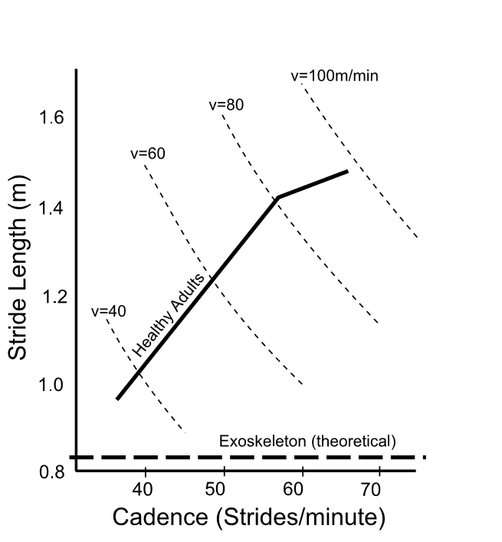

Slide 16
Determining a Starting Point for a New Exoskeleton Pilot
Small people tend to walk with smaller steps at a higher step rate than larger people
This observation can be expressed as variation in the relationship between stride length and cadence as a function of height
When tailoring a gait to a new exoskeleton user it would be useful to be able to scale gait as a function of pilot dimensions. This would expedite the tuning process for a given user.
A method of gait scaling by dimensionless numbers is discussed in detail and the relevant equations for this approach are listed in Table 5.

Slide 17
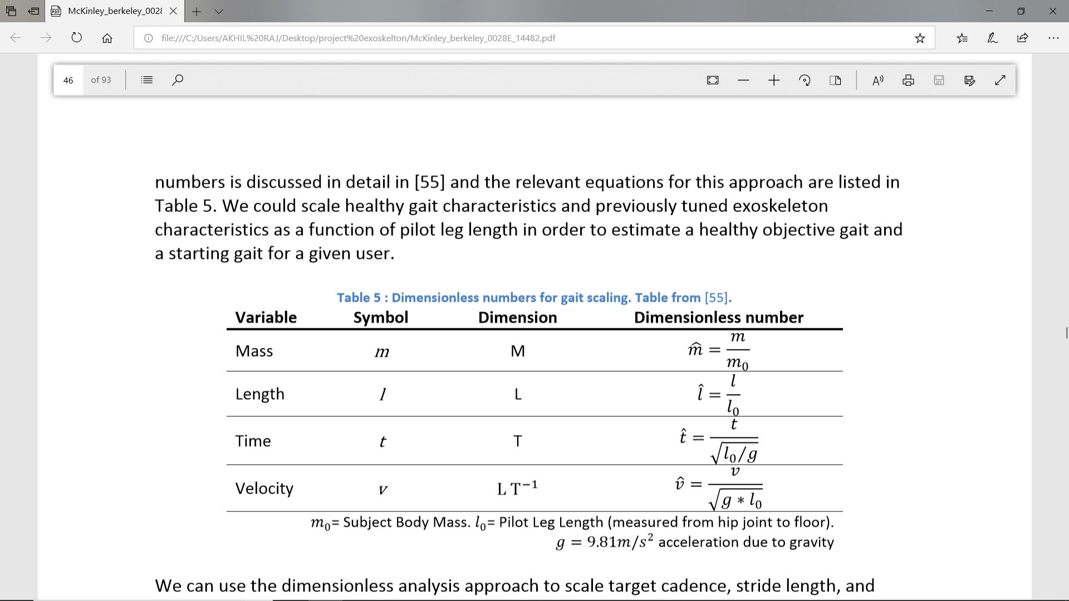
We can use the dimensionless analysis approach to scale target cadence, stride length, and velocity as a function of leg length 𝑙0 (where leg length is measured from hip joint to the floor
Normalized velocity=velocity/sqrt(g*lo)
Normalized stride length=stride length/lo
Normalized cadence=cadence*t/(sqrt(lo/g))

Slide 18
Practical Approach to Determining Gait as a Function of Speed
The pilot is allowed to walk freely with given amplitude and period for selecting the optimal speed.
It’s a kind of utilizing adapting walking style of humans for selecting the optimal speed

Slide 19
Practical Approach to Accelerating
It was observed that most walking falls into two categories: Slow speed walking to negotiate tight environments, and high speed walking
A threshold step command frequency was selected and was used as a gating condition to transition
Steps commanded at a rate slower than the threshold frequency keep the FSM in a slow speed loop
. When the step frequency threshold is exceeded gait automatically accelerates with each step until a top speed is attained
Upon pausing or bringing feet together, the gait resets back to a slow speed

Slide 20
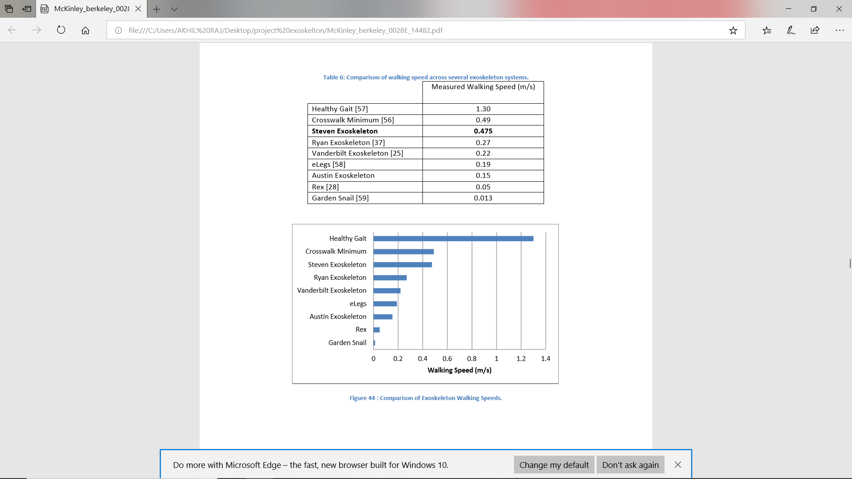
SPEED CAMPARISON OF VARIOUS EXOSKELTONS

Slide 21
CHARACTERISTICS OF STEVEN EXOSKELTON
It allows body control from seated position to some extend
The Steven Exoskeleton offers the opportunity to enhance the capabilities of the seated wheelchair user as it is small and light enough to stay out of the way during daily activities.
The importance of shoulder straps increases as erector spinae muscle strength decreases
The posture of the Steven Exoskeleton is actively controlled while seated
Knee joint torque is typically required for healthy standing and sitting. Although the Steven Exoskeleton does not provide actuation at the knees, it is still possible to sit and stand with minimal effort

Slide 22
STANDING TECHNIQUE AND STEVEN EXOSKELTON
When a healthy individual stands up (without the use of his/her arms) the torso is first flexed and then extended in an effort to move his/her center of mass (CoM) as close to the center of support as possible
It has been observed that people with reduced muscle capacity increase torso flexion and angular velocity in an effort to bring the CoM closer to ones center of support and to increase momentum
Movement of the center of mass from seated to standing is accomplished through the combination of joint torques and angular momentum generated by torso movement
Since this exoskeleton doesn’t have knee actuation, some postures available to healthy individuals must be reconsidered for use with a minimally actuated exoskeleton. We can gain insight from strategies used by amputees and individuals with impaired muscle strength

Slide 23
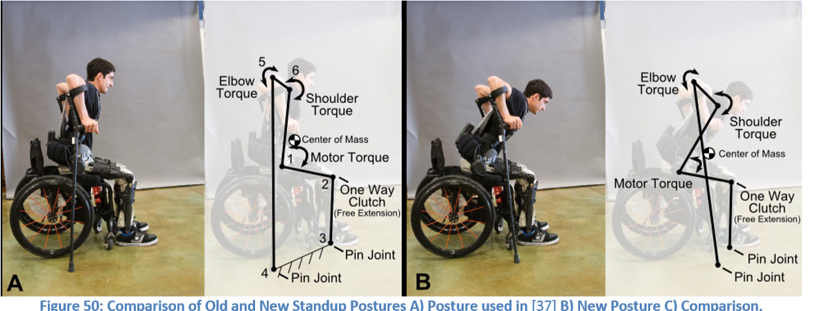
STEVENS STANDING TECHNIQUES

Slide 24
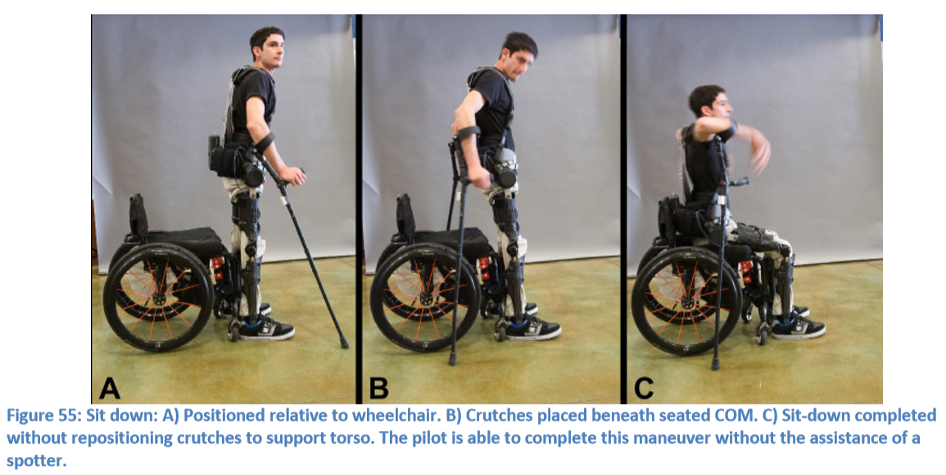
Sit-down Trajectory
During sit-down the knees unlock, and the hips are position controlled until a predefined angle is reached. Once this angle is attained, the controller automatically switches to a torque control mode which works together with the muscle contributions from the user to sit down smoothly
This method has been extremely well received by exoskeleton pilots

Slide 25
Making an Exoskeleton Best Suit Its Pilot
Improper fit can pose problems with skin integrity and can lead to restriction of a user's range of motion, agility, and balance
A pilot’s body dimensions are first measured before fitting the exoskeleton
A pilot is asked to sit in his wheelchair with feet flat on the floor. Torso Length is measured from the top of the shoulder (where a backpack strap would sit) to the rotational center of the hip as viewed in the sagittal plane
Femur length is measured from the rotational center of the hip to the rotational center of the knee as viewed in the sagittal plane
Shank length is measured from the approximate rotational center of the knee to the floor. Hip width is measured from the bony protuberances of the pelvic bones as viewed in the coronal plane

Slide 26
PADS AND STRAPS
It is advantageous to minimize the size of support pads in order to reduce overall mass and insulating properties
By increasing contact area, it is possible to reduce tissue pressure and thereby reduce the odds of pressure sores. However, users quickly become too hot as a result of covering large regions of the body with foam.
Shoulder straps are used to keep the pilot’s shoulders aligned with the exoskeleton. Straps are attached to the exoskeleton above the shoulder to minimize strap pressure on the shoulder and pectoral regions

Slide 27
The lumbar pad is placed to support the lumbar sacral region and extends 2.5cm below the coccyx. It is important to minimize the risk of pressure ulcers by reducing pressure points for patients without sensation in this area.
A thigh pad is positioned to maintain hip alignment during transitional periods such as standup and sit-down
The knee pad should be positioned below the patella to ensure direct support of the tibial tuberosity
This pad should be rigidly positioned so as to ensure colocation of exoskeleton and pilot knee joints
The knee pad is typically constructed of 1cm thick EVA 30 foam to ensure that the pilot’s knee tissues are safely supported during load bearing phases.

Slide 28
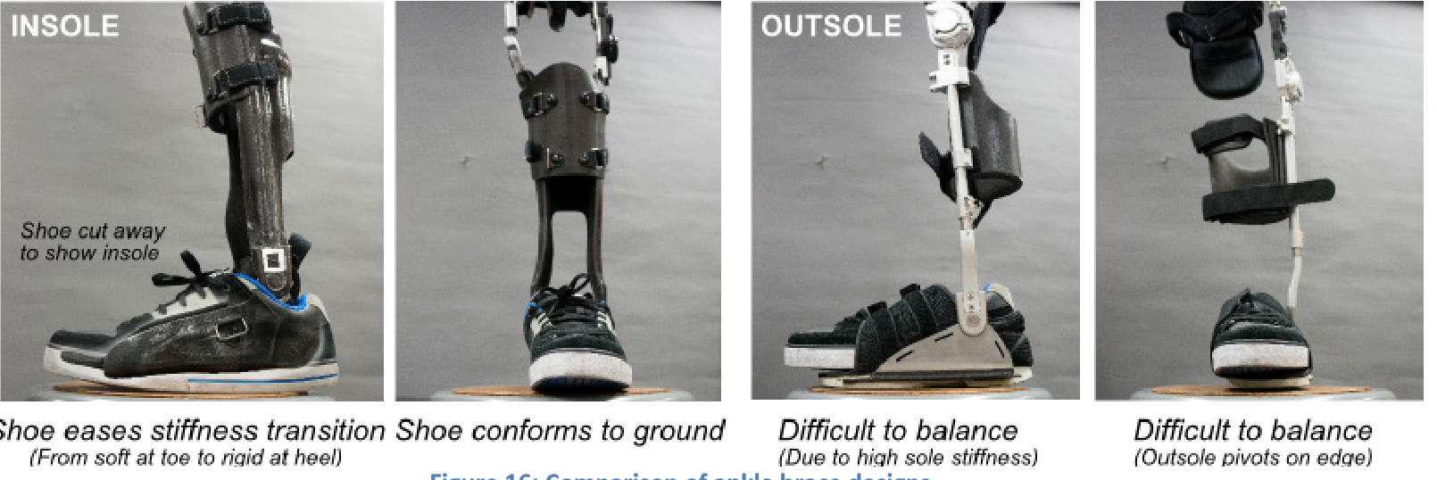
COMPARISON OF ANKLE BRACE DESIGNS.
The exoskeleton ankle is designed to protect the pilot’s ankle by limiting abduction/adduction, plantar/dorsiflexion, and inversion/eversion

Slide 29
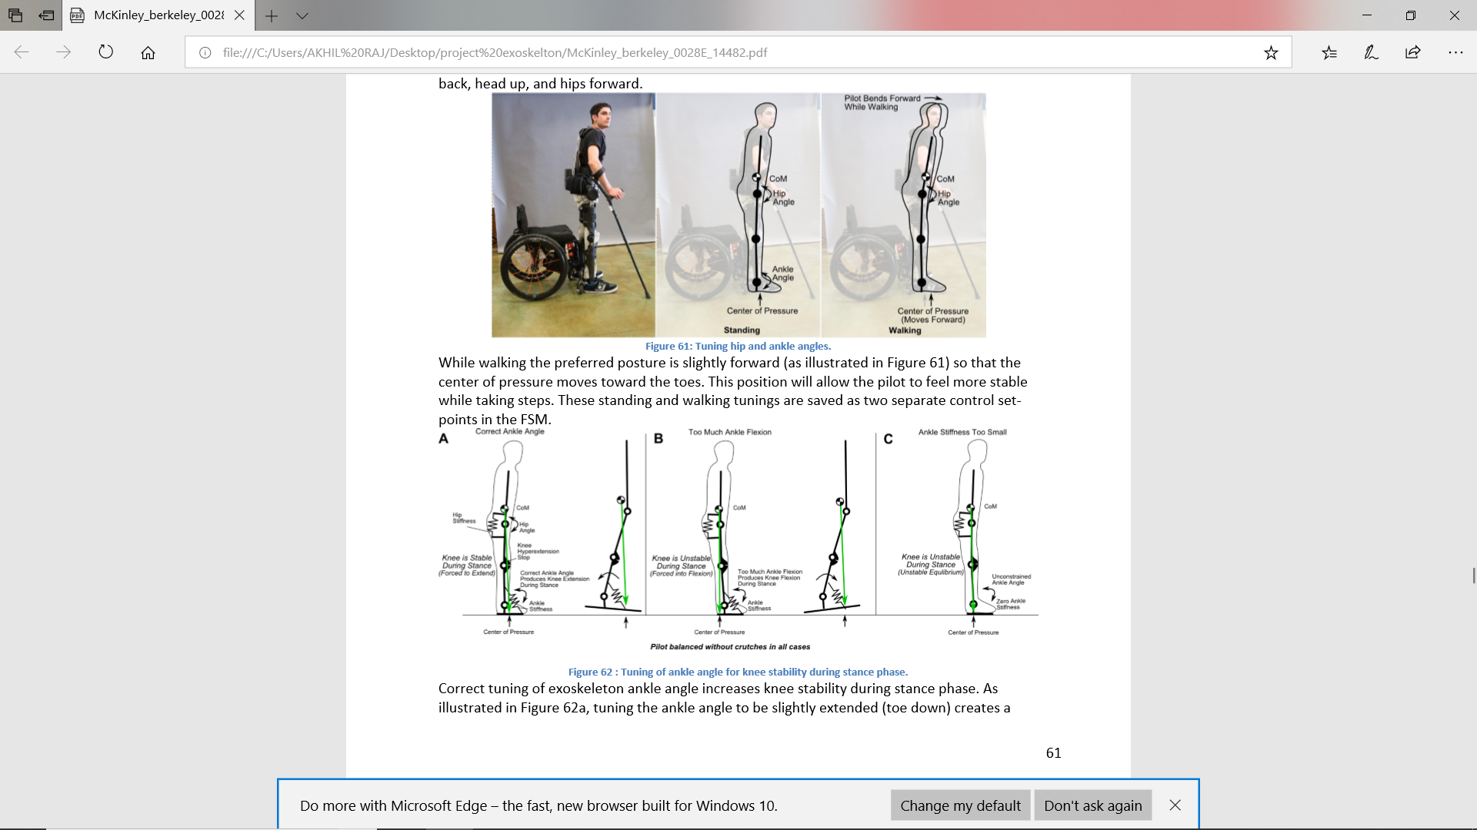
POSTURE FOR STATIC BALANCE AND WALKING

Slide 30
Correct tuning of exoskeleton ankle angle increases knee stability during stance phase
Tuning the ankle angle to be slightly extended (toe down) creates a knee extension moment during stance (extension is limited by a hyperextension hard stop).
knee is unstable if the ankle is biased slightly flexed (toe up) as illustrated in Figure 62b

Slide 31
DEVELOPING A LIGHTWEIGHT HANDHELD USER INTERFACE
The user interface (UI) plays a critical role in the overall safety, reliability, and performance of an exoskeleton system
ReWalk uses a wrist mounted interface to change modes [30] while individual steps are commanded by leaning the torso forward to a threshold angle
eLegs uses an IMU to measure of upper arm orientation to initiate steps. Sensors on crutch and foot act to filter out unwanted step commands
Vanderbilt’s Indego uses estimated center of pressure as measured by a torso mounted accelerometer to control standing, sitting, and walking by estimating center of pressure motion

Slide 32
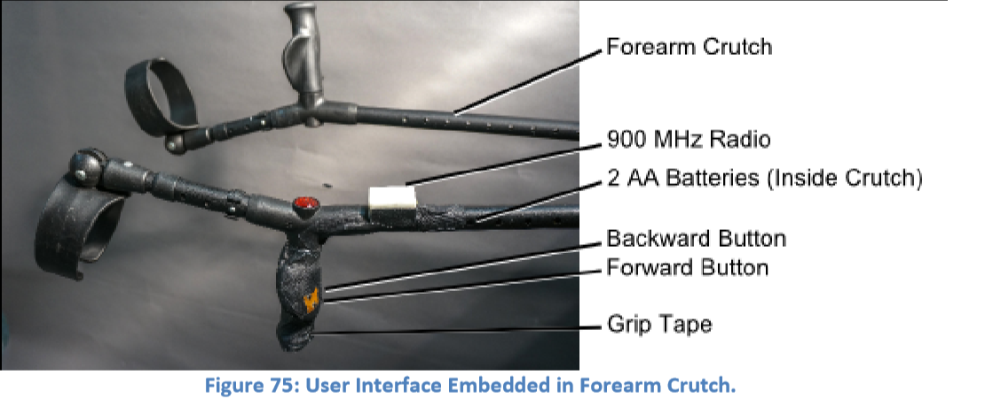
Rex was designed to self-balance through numerous powered degrees of freedom
Users command the system via control pad and joystick
Although changing modes requires numerous keypad interactions, users have plenty of time to calculate their next move as mobility is limited by Rex’s extremely slow speed

Slide 33
MAIN BOARD DESIGN AND HIGH POWER SYSTEM
In order to protect pilot and engineer, operating voltages and motor power should be kept as low as possible, systems should be designed to fail gracefully, and schematics and code should be easy to understand.
. The Maxon EC-90-flat electric motor and SHD-20-100-2SH 100-to-1 transmission Harmonic Drive have been sufficient for recent exoskeletons
Batteries are selected that provide required bus voltage, continuous, and peak current ratings

Slide 34
Battery energy capacity is proportional to battery volume thereby making it advantageous to select the smallest possible battery for volume and weight savings
Recent exoskeletons a pair of 25.9v nominal 2.1Ah Lithium Polymer Battery packs connected in series were used to produce 51.8v nominal
These packs were specified to deliver enough power for approximately 4 hours of continuous walking or 8 hours of average use. Each pack weighs 0.9 lbs
Amplifiers are selected that meet the required motor performance and battery specifications
Copley Bantam BTM-090-10 amplifiers were selected for the Ryan, Steven, and Daniel exoskeletons based on their current and voltage ratings.

Slide 35
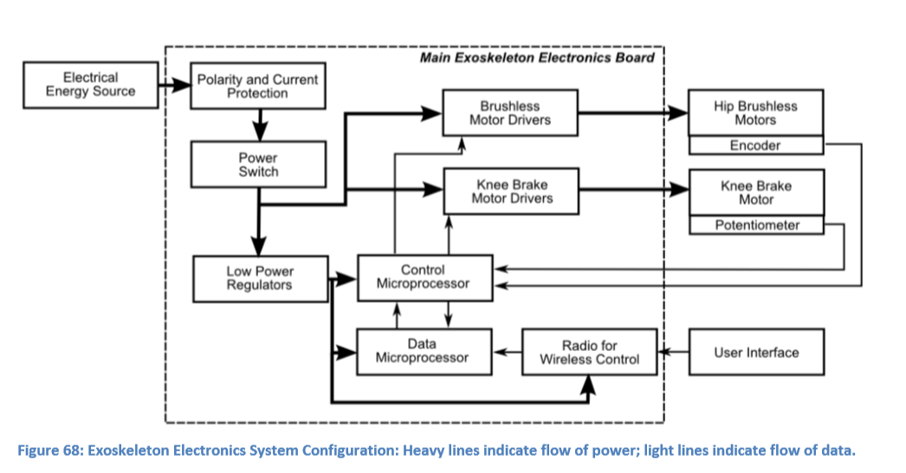
ELECTRONICS SYSTEM ARCHITECTURE

Slide 36
BATTERY CHARGING
An in-pack management board takes care of cell balancing and monitors cell voltage and current draw
This circuitry is included with the 25.9v nominal 2.1Ah Lithium Polymer Battery packs and is designed to safeguard the batteries against over charge/discharge and extreme current draw situations
This data would provide a level of pilot security as unexpected pack failures could be avoided. A custom battery management board would enable accurate monitoring of individual cell health and overall pack capacity

Slide 37
REDUCTION IN MASS
Reducing system mass, (especially the mass of the torso unit) greatly simplifies difficult maneuvers such as standing and sitting
Dead weight can be easily trimmed from several areas:
The hip module and associated adjustment system could be redesigned for more efficient material placement
A redesign of these structures for minimized foam thickness could result in a lighter system and would keep the pilot cooler
Mass could be removed without compromising structural integrity.
Additional weight could be removed through a redesign of the flexible spine support

